Slide 1

JADS MKBdatalab Masterclass Introduction to Time Series Forecasting
Danielle Paes Barretto
April 25, 2023
Notes:
Photo by Aron Visuals on Unsplash

Slide 2
“ The goal of forecasting is not to predict the future but to tell you what you need to know to take meaningful action in the present. ”
- Paul Saffo

Slide 3
Overview

Slide 4
Time Schema
13:00 – 15:00 – Introduction to Time Series Forecasting (Part 1 of 2)
15:00 – 15:30 – Break
15:30 – 17:00 – Introduction to Time Series Forecasting (Part 2 of 2)

Slide 5
Datasets
Some datasets are made available in GitHub. Mostly from Google trends. These will be used to explore time series properties.
The main dataset can be found and download at https://www.kaggle.com/competitions/demand-forecasting-kernels-only/data . You can find the description of the dataset there.
This will be the main dataset used to explore the forecasting models presented here.
Some suggestions of datasets for further exploration are given at the end of this presentation.

Slide 6
Store Item Demand Forecasting Challenge Predict 3 months of item sales at different stores
5 years of store-item sales (01-01-2013 until 31-12-2017)
Kaggle objective forecast 3 months (01-01-2018 until 31-03-2018) of sales for 50 different items at 10 different stores.
Our objective forecast 3 months (01-01-2018 until 31-03-2018) of sales for item 28 at store. Download this data from data/processed/sales_store_2_item_28.csv.
For both models presented here (ARIMA and Prophet) you need to forecast the sales of each product in each store individually. This can be done by using the model for each product-store combination and then combining the results.
Is there a forecasting model that can be applied to the whole dataset at once? Yes, there are other forecasting models such as exponential smoothing and neural networks that can be applied to a dataset as a whole.

Slide 7
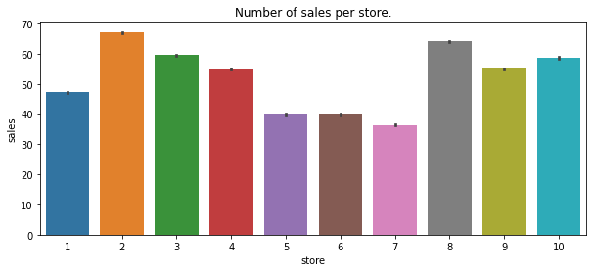
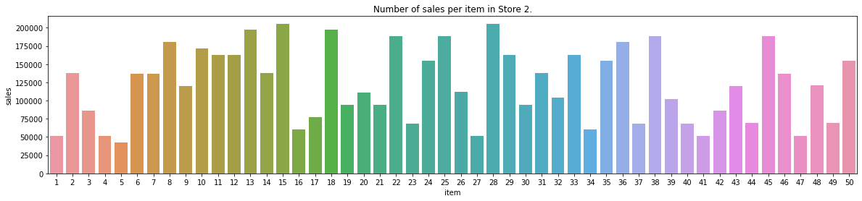
EDA

Slide 8
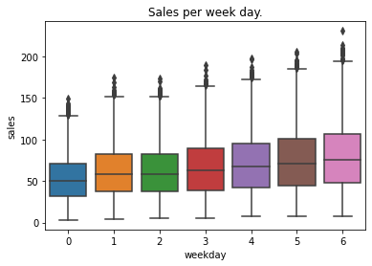
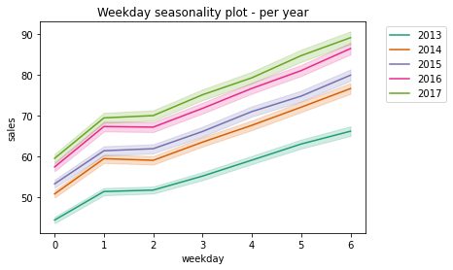
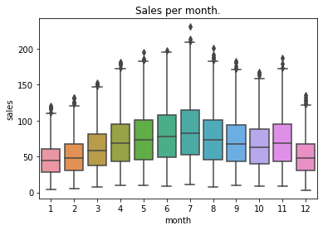
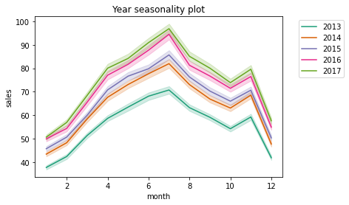
EDA

Slide 9
What is a Time Series?
A time series is a sequence of data points with the follow characteristics
Sequence of data points taken over a continuous time interval
Each data point is a measurement taken at successive points in time
There is equal spacing between every two consecutive measurements
Each time unit within the interval has no more than one data point

Slide 10

What is Forecasting?
It is a tool used to predict future outcomes based on past data and current trends.
It can help businesses make better decisions.
It can inform government policy decisions.
Ultimately, it benefits the population by ensuring resources are allocated in the most effective way.

Slide 11
Examples of Forecasting Applications
Financial: Stock market predictions, currency exchange rate forecasting, investment portfolio optimization.
Retail: Demand forecasting, inventory management, pricing optimization.
Healthcare: Disease outbreak forecasting, medical treatment effectiveness, medication side effects.
Weather: Climate change predictions, hurricane tracking, air quality predictions.
Manufacturing: Production planning, supply chain management, machinery maintenance.
Energy: Renewable energy forecasting, energy usage optimization, power grid maintenance.
Transportation: Traffic flow predictions, airline scheduling, ride-sharing optimization.
Sports: Team performance predictions, player performance analysis, win probability estimations.
Advertising: Ad placement optimization, campaign effectiveness, customer segmentation.
Security: Intrusion detection, anomaly detection, malware analysis.

Slide 12
The Business Problem
Forecast 3 months (01-01-2018 until 31-03-2018) of sales for item 28 at store.

Slide 13
Time Series Components

Slide 14
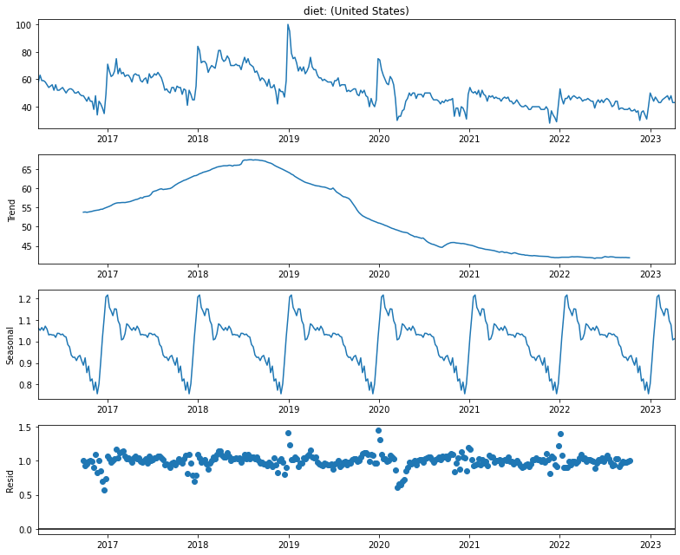

Slide 15
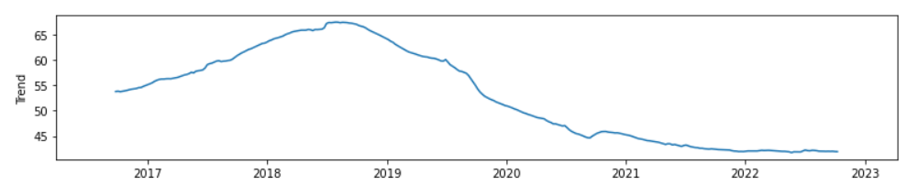
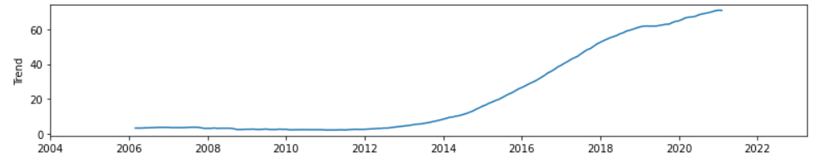
Trend
Shows whether the series is consistently decreasing (downward trend), constant (no trend) or increasing (upward trend) over time.

Slide 16
Seasonality
Describes the periodic signal in your time series. Seasonality should always present a fixed and known period.
These changes usually happen on a regular basis, like on a daily, weekly, or yearly basis. Seasonality is usually caused by natural cyclical patterns or by the conventions of the people regarding certain dates and times.

Slide 17
Cyclical Patterns
Cycles are patterns of peaks and dips in a time series that are caused by how the value in the series at one time is determined by the values at earlier times. This type of behaviour can be seen in economies, epidemics, animal populations, volcano eruptions, and other natural processes.

Slide 18
Seasonality vs Cyclicality
The difference between cyclic behaviour and seasonality is that cycles don't necessarily depend on the particular date of occurrence - it's more about what has happened in the recent past. This independence from time makes cycles much less regular than seasonal patterns.

Slide 19


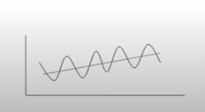
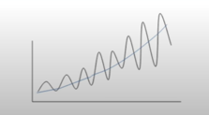
Additive x Multiplicative Model
Y(t) = trend + seasonality + residual
Y(t) = trend + seasonality + residual
Trend and Seasonal variation relatively constant over time.
Trend and Seasonal variation increases or decreases in magnitude over time.
Notes:
Additive
* Linear trend: trend is a straight line
* Linear seasonality: Seasonality with same frequency (width of cycles) and amplitude (height of cycles).
Multiplicative
* Non-linear trend: trend is a curved line
Non-linear seasonality: Seasonality varies in frequency (width of cycles) and/or amplitude (height of cycles).
One of the main objectives for a decomposition is to estimate **seasonal effects** that can be used to create and present seasonally adjusted values (https://online.stat.psu.edu/stat510/lesson/5/5.1). So to choose between additive and multiplicative decompositions we consider that:
* The additive model is useful when the seasonal variation is relatively constant over time.
* The multiplicative model is useful when the seasonal variation increases over time.

Slide 20
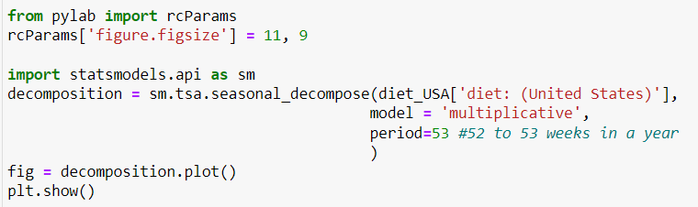
Time Series Decomposition
We will have the help of the Python’s statsmodels library seasonal_decompose to access the components of time series.

Slide 21

on time….
Let’s decompose some time series and analyze:
Trend,
Seasonality vs Cyclicality,
Additive vs Multiplicative behavior
Use library seasonal decompose to decompose time series on datasets:

Slide 22
Stationarity
A stationary time series fulfills the following criteria:
Trend zero
The variance in the seasonality component is constant: The amplitude of the signal does not change much over time.
Autocorrelation is constant: The relationship of each value of the time series and its neighbors stays the same.
Why is it important?
If a time series exhibits a certain behavior over a period of time, then it is likely that it will have the same behavior over a different time period, so long as the time series is stationary. This helps in making forecasts with a higher degree of accuracy. Algorithms such as ARIMA and its variants rely on this property.

Slide 23
Stationarity tests
Augmented Dicky-Fuller test (ADF)
Null Hypothesis: The series has a unit root, meaning it is non-stationary. It has some time dependent structure.
Alternate Hypothesis: The series has no unit root, meaning it is stationary. It does not have time-dependent structure.
A p-value below a threshold (such as 5% or 1%) suggests we reject the null hypothesis (stationary), otherwise a p-value above the threshold suggests we fail to reject the null hypothesis (non-stationary).
Kwiatkowski-Phillips-Schmidt-Shin (KPSS)
Null Hypothesis: The process is trend stationary.
Alternate Hypothesis: The series has a unit root (series is not stationary).
A p-value below a threshold (such as 5% or 1%) suggests we reject the null hypothesis (non-stationary), otherwise a p-value above the threshold suggests we fail to reject the null hypothesis (stationary).
Important: Apply both since it can happen that a time series passes the ADF test, without being stationary.

Slide 24
on time….
Let’s test for stationarity using ADF and KPSS tests.
 | ADF | KPSS | Conclusion
Case 1 | p > threshold (non-stationary) | p < threshold (non-stationary) | TS is not stationary
Case 2 | p < threshold (stationary) | p > threshold (stationary) | The series is stationary
Case 3 | p > threshold (non-stationary) | p > threshold (stationary) | The series is trend stationary
Case 4 | p < threshold (stationary) | p < threshold (non-stationary) | The series is difference stationary

Slide 25
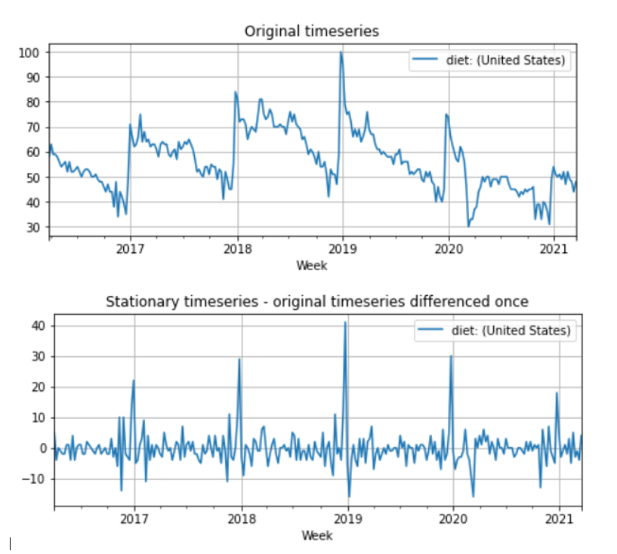
Making Time Series Stationary

Slide 26
ARIMA models

Slide 27
Auto Regressive Integrated Moving Average models
There are two types:
Non-seasonal ARIMA, or simply ARIMA
Seasonal ARIMA, or SARIMA
(S)ARIMAX is a extension of the ARIMA model using exogenous variable, i.e., variables that might have influence on the target. For instance, temperature might help in predicting the number of ice cream sold, the number of nurses in a shift might have influence on the waiting time of patients.

Slide 28
Non-seasonal ARIMA
ARIMA (p, d, q)
AR (p) : AutoRegressive component
I (d) : differencing component
MA (q) : Moving Average component
Number of periods of the TS used in the calculation
Number of transformations used to transform a TS into a stationary one
Number of lags of the error component
Notes:
Purely AR models look like linear regression models where the predictive variables are the p previous periods.
A stationary series is a series without trend or seasonality
Error component: The part of the series not explained by trend or seasonality
MA models look like linear regression models where the predictive variables are the q previous periods of errors

Slide 29
Stationarity and ways of making TS stationary.
Stationary time series has mean and variance constant over time.
Differencing is a method of transforming a non-stationary time series to a stationary one.
The number of times of differencing needed to render the series stationary will be the differenced I(d) term in our ARIMA model.
ADF and KPSS tests can help to know how many times or if differencing is the way to go.
However, other common transformations for enforcing stationarity include (sometimes in combination with one another):
Square root or N-th root transformations
De-trending your time series
Differencing your time series one or more times
Log transformations
Note, however, that a transformation on data as a pre-processing stage will result in forecasts in the transformed space. When in doubt, let the auto_arima function do the heavy lifting for you. Read more on difference stationarity in this Duke article.
Notes:
Station

Slide 30
Tip from pmdarima
The easiest way to make your data stationary in the case of ARIMA models is to allow auto_arima to work its magic, estimate the appropriate d value, and difference the time series accordingly. However, other common transformations for enforcing stationarity include (sometimes in combination with one another):
Square root or N-th root transformations
De-trending your time series
Differencing your time series one or more times
Log transformations
Note, however, that a transformation on data as a pre-processing stage will result in forecasts in the transformed space. When in doubt, let the auto_arima function do the heavy lifting for you. Read more on difference stationarity in this Duke article.

Slide 31
Autocorrelation Function (ACF) Plot (correlogram)
Autocorrelation : How correlated a time series is with its past values.
If the time series is non-stationary we need to use differencing to make it stationary. After making the time series stationary we can use the ACF of the stationary time series to define if we will use AR, MA or both components, as well as how many lags we should use.
If the stationarized series has a positive correlation at Lag-1, AR terms are the best. If it has a negative correlation at Lag-1, then MA terms are best.
The decay or cut off of the ACF will give us hints at what terms to use, as well as spikes decaying towards 0.
Following, we take a look at PACF that will help us confirming our findings.
EXPLAIN WITH AN EXAMPLE – GRAPH BEFORE AND AFTER DIFFERENCING
CHECK ALSO CORRECTION OF THE COMMENT

Slide 32
Partial Autocorrelation Function Plot
Partial correlation: The correlation between two variables controlling for the values of another set of variables.
ACF calculates the correlations of each of the previous points with a value.
PACF calculates the correlations of these points controlling for the values of all previous lag variables.
PACF suggests how many AR or MA terms you need to use to explain the autocorrelation pattern in the time series.
If the PACF drops off at lag number k, it generally indicates an AR(k) model.
If it drops off more gradually, it suggests a MA model

Slide 33
Autoregressive (AR) Component (p)

Slide 34
Moving Average (MA) Component (q)
MA pure components smooths sundle jumps in a time series.
Indicators that points for using MA terms in a ARIMA model are:
MA series are usually negatively correlated at Lag-1
ACF that cuts off sharply after a few lags
PACF that decreases out more gradually

Slide 35
Integrated (I) Component (d)
Number of times we have to difference our dataset to make it stationary.
If the time series must de differenced to be made stationary, we consider it integrated.
Using the information extracted from AFC, PAFC, and the number of times we needed or not do differenced our time series we obtain the parameters p,d, q, i.e. ARIMA(p,d,q)

Slide 36
Seasonal ARIMA Models
Non - Seasonal
Seasonal
ARIMA(p, d, q)
ARIMA(p, d, q)(P,D,Q)m
p: Autoregressive component
d: Differencing component
q: Moving Average component
p, d, q : like in the non-seasonal ARIMA
m: Number of periods in each season (e.g. monthly data m=12)
P: Autoregressive component for the seasonal part
D: Differencing component for the seasonal part
Q: Moving average component for the seasonal part

Slide 37
Seasonal Differencing

Slide 38
Seasonal AR and MA Terms (P, Q)
AR TERMS
MA terms
ACF slowly decays
PACF drops to zero
Most appropriate when seasonal autocorrelation is positive
ACF drops to zero
PACF slowly decays
Most appropriate when seasonal autocorrelation is negative
Notes:
To obtain the seasonal ARIMA terms P and Q we use the patterns appear in ACF and PACF plots that use seasonal lag

Slide 39
Estimating coefficients numerically
ACF and PACF plots can help us find appropriate values for parameters `p` and `q` . However, the interpretation of these plots is not always clear.
The numerical method consists in fitting the ARIMA model and observing the values of AIC (Akaike Information Criterion) and BIC (Bayesian Information Criterion).
For both criterium the smaller the better.
Usually there is a agreement between AIC and BIC. If there is no agreement choose smaller AIC for a predictive model and smaller BIC for a explanatory model (less complex)
Notes:
The Akaike Information Criterion (AIC) and the Bayesian Information Criterion (BIC) are two widely used criteria for selecting the optimal parameters of an ARIMA model. The general rule of thumb is that the model with the lowest AIC or BIC values should be chosen. However, it is important to keep in mind that the AIC and BIC do not always select the same model as the best one. In some cases, the AIC may select a model with higher complexity than the BIC, or vice versa. In such cases, it may be necessary to evaluate the models using other criteria, such as the out-of-sample predictive accuracy of the models. Ultimately, the choice of the best ARIMA model should be based on the balance between model complexity and predictive accuracy.

Slide 40
Notes:
The Ljung–Box test is a statistical test used to evaluate autocorrelation of residuals in an autoregressive model such as an ARIMA model. It is used to determine whether the residuals of an ARIMA model follow a white noise process. The test statistic is the sum of squared autocorrelations of the residuals at lags 1 to k, and is compared against critical values from the chi-squared distribution with k degrees of freedom. If the test statistic is greater than the critical value, then the null hypothesis of no autocorrelation is rejected. This suggests that the model should be improved.
The Jarque–Bera test is a statistical test used to assess the validity of ARIMA models. It is based on the skewness and kurtosis of the residuals. The test statistic is defined as: JB = n/6 x (S2 + (K – 3)2/4) Where n is the number of residuals, S is the sample skewness, and K is the sample kurtosis. If the JB statistic is greater than the critical value of the chi-squared distribution at a given significance level, then the null hypothesis of a normal distribution is rejected, indicating that the ARIMA model is not valid. This suggests that the model is not capturing the underlying structure of the data and is not an accurate representation of the system being modeled.

Slide 41
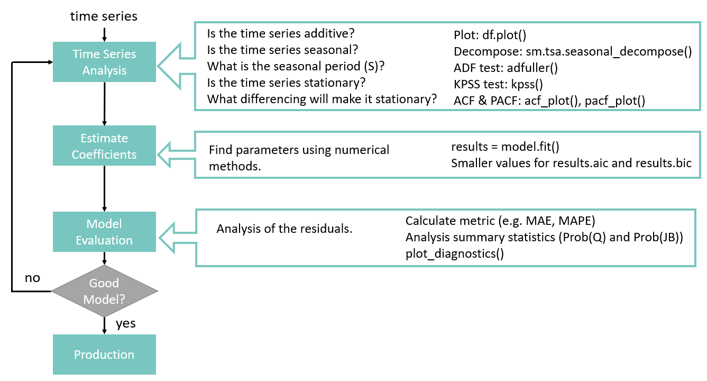
Box-Jenkins Method

Slide 42
on time….
Load sales_store_2_item_28.csv
Apply Box-Jenkins Method
STEP 1 : Identify
Visualize components
Stationary?
ACF plot
PACF plot
STEP 2: Estimate coefficients numerically
Run model for different parameters (p,d)
Evaluate AIC and BIC
Choose parameters
STEP 3: Evaluate model
Prob(Q) < threshold (There are correlations)
Prob(JB) < threshold (Residuals are NOT normally distributed)

Slide 43
Forecasting with Facebook Prophet
How to apply Facebook Prophet for forecasting
How to search for the best model using hyperparameter fine tunning
How to evaluate the obtained model
How to save the chosen model for future use

Slide 44

Facebook Prophet
Open-source forecasting tool available in R and Python.
Open sourced in 2017 Facebook’s core Data Science team. It is full optimized for the business forecasts tasks they encountered at Facebook. It is still used internally.
Prophet is a procedure for forecasting time series data based on an additive model, and the implementation supports trends, seasonality, and holidays.
It works best with time series that have strong seasonal effects and several seasons of historical data.
Prophet is robust to missing data and shifts in the trend, and typically handles outliers well.
Accurate and Fast: Still used internally by Facebook for producing reliable forecasts for planning and goal setting. Fit models in Stan so that you get forecasts in just a few seconds.
Fully automatic: Has the capacity of find automatically a good set of hyperparameters for the model so non-experts users can quickly make high quality forecasts.
Tunable Forecasts: Prophet allows also hand tunning parameters so experts can improve theirs results.
Notes:
Stan is a state-of-the-art platform for statistical modeling and high-performance statistical computation.

Slide 45
Probable datasets
https://www.kaggle.com/datasets/kishorkhengare/cement-sales-demand/code
https://www.kaggle.com/code/kishorkhengare/notebook-cement-sales-and-demand-forecasting
https://www.kaggle.com/datasets/ujjwalchowdhury/walmartcleaned
https://public.tableau.com/app/resources/sample-data

Slide 46
Links
https://facebook.github.io/prophet/
https://github.com/facebook/prophet
Example Prophet using holidays and weather effects: https://nbviewer.org/github/nicolasfauchereau/Auckland_Cycling/blob/master/notebooks/Auckland_cycling_and_weather.ipynb

Slide 47
Questions? Comments?

Slide 48


Slide 49

Thanks!
mkb

